Slide 1
Male Reproductive System
Sexual reproduction and development
Male reproductive anatomy
Puberty and climacteric
Sperm and semen

Slide 2
Essence of Sex
Reproduction
  a property of a living thing
Sexual reproduction
  each offspring has 2 parents and receives genetic material from both
  provides genetic diversity
  foundation for survival and evolution of species

Slide 3
Two Sexes
Male and female gametes (sex cells) combine their genes to form a fertilized egg (zygote)
  one gamete has motility (sperm)
    parent producing sperm considered male
    has Y chromosome
  other gamete (egg or ovum) contains nutrients for developing zygote
    parent producing eggs considered female
    has X chromosome
    in mammals female also provides shelter for developing fetus (uterus and placenta)

Slide 4
Overview of Reproductive System
Primary sex organs
  produce gametes (testes or ovaries)
Secondary sex organs
  male - ducts, glands, penis deliver sperm cells
  female - uterine tubes, uterus and vagina receive sperm and nourish developing fetus
Secondary sex characteristics
  develop at puberty to attract a mate
    pubic, axillary and facial hair, scent glands, body morphology and low-pitched voice in males

Slide 5
Role of Sex Chromosomes
Our cells contain 23 pairs of chromosomes
  22 pairs of autosomes
  1 pair of sex chromosomes (XY males: XX females)
    males produce 50% Y carrying sperm and 50% X carrying
    all eggs carry the X chromosome
Sex of child is determined by a type of sperm that fertilizes mother’s egg

Slide 6
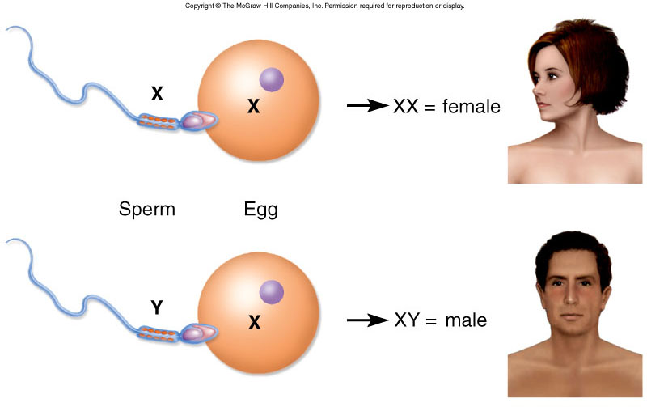
Embryonic Development

Slide 7
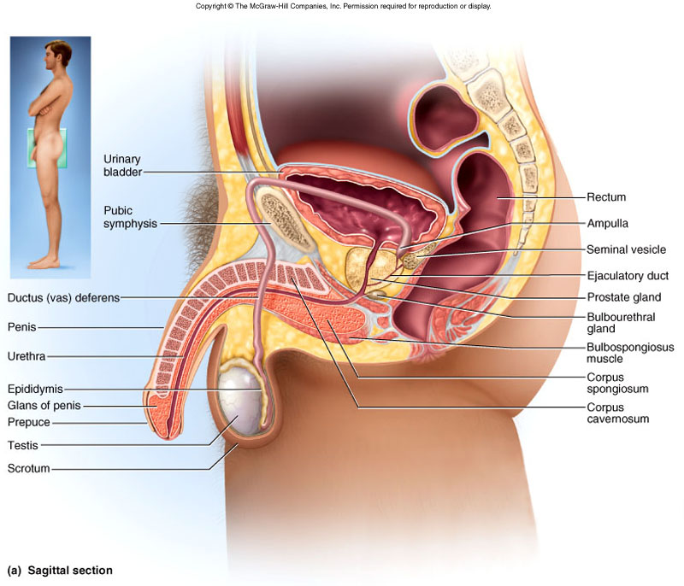
Male Reproductive System

Slide 8
Scrotum
Pouch holding testes
  divided into 2 compartments by median septum
Spermatic cord travels up from scrotum to pass through inguinal canal
  contains testicular artery, vein, nerve and lymphatics

Slide 9
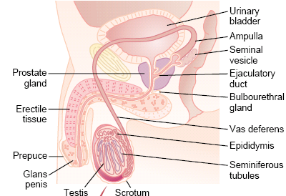
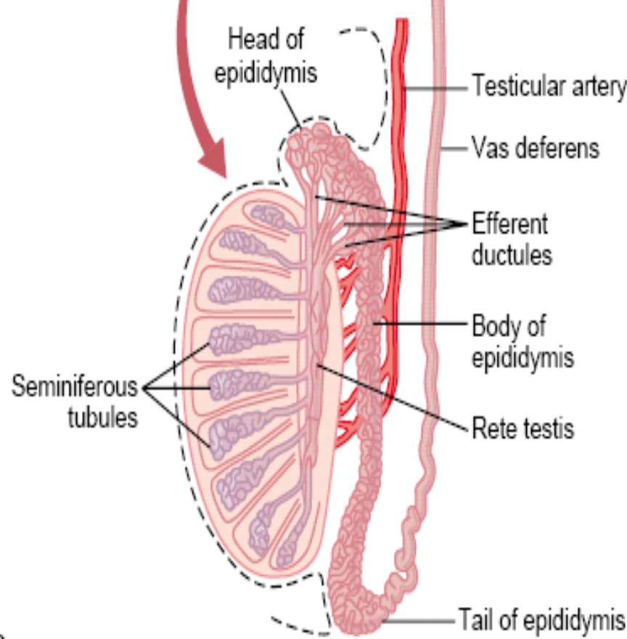
Reproductive system

Slide 10
Spermatic Ducts
Efferent ductules
  12 small ciliated ducts collecting sperm from rete testes and transporting it to epididymis
Epididymis (head, body and tail)
  6 m long coiled duct adhering to posterior of testis
  site of sperm maturation and storage (fertile for 60 days), where they become mature.

Slide 11
Ductus deferens (peristalsis during orgasm)
  muscular tube 45 cm long passing up from scrotum through inguinal canal to posterior surface of bladder
Ejaculatory duct
  2 cm duct formed from ductus deferens and seminal vesicle and passing through prostate to empty into urethra

Slide 12
Puberty and Climacteric
Reproductive system remains dormant for years after birth
  surge of pituitary gonadotropins begins development
    10-12 in most boys; 8-10 in most girls
Puberty
  period from onset of gonadotropin secretion until first menstrual period or first ejaculation of viable sperm
Adolescence
  ends when person attains full adult height

Slide 13
Other Effects of Testosterone
Enlargement of secondary sexual organs
  penis, testes, scrotum, ducts, glands and muscle mass enlarge
  hair, scent and sebaceous glands develop
  baldness
  stimulates erythropoiesis and libido
During adulthood, testosterone sustains libido, spermatogenesis and reproductive tract

Slide 14
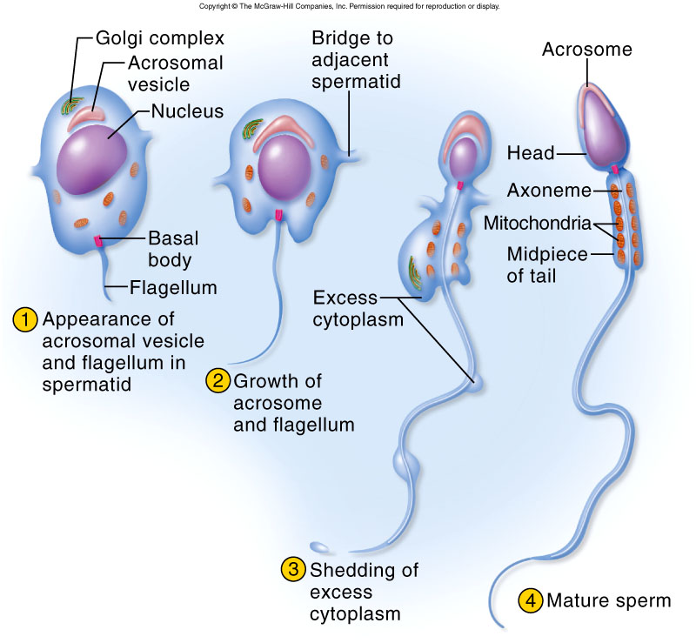
Spermatogenesis
Spermatogonia produce 2
kinds of daughter cells
  type A remain outside blood-testis
  barrier and produce more
  daughter cells until death
  type B differentiate into
  primary spermatocytes
    cells must pass through
    BTB to move inward
    toward lumen - new tight
    junctions form behind
    these cells
    meiosis I → 2 secondary
    spermatocytes
    meiosis II → 4 spermatids

Slide 15
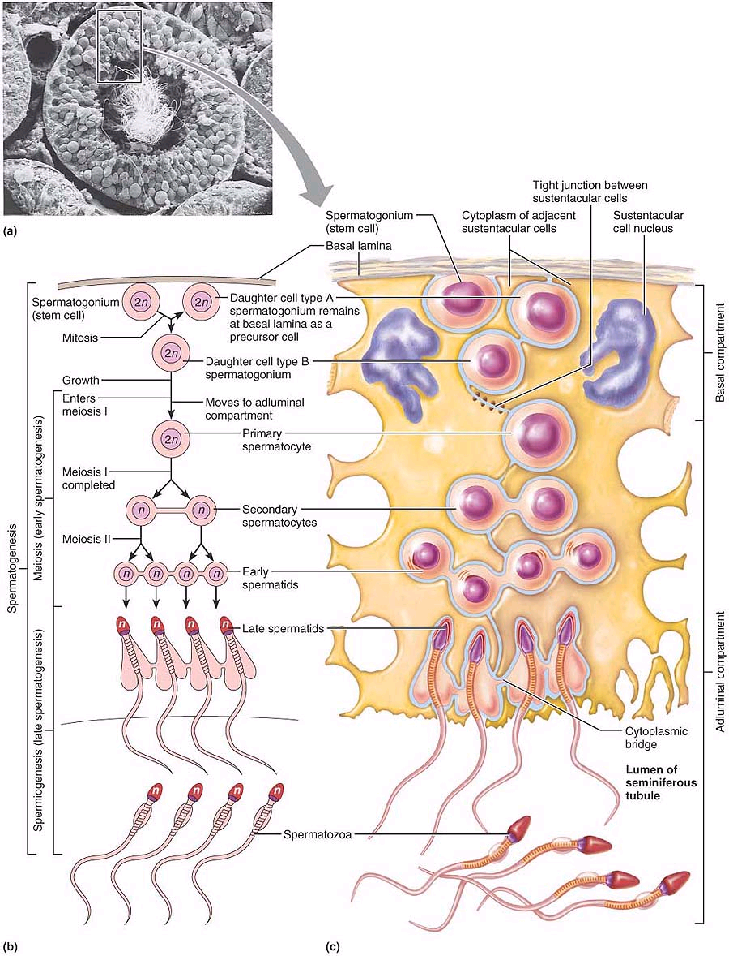

Slide 16
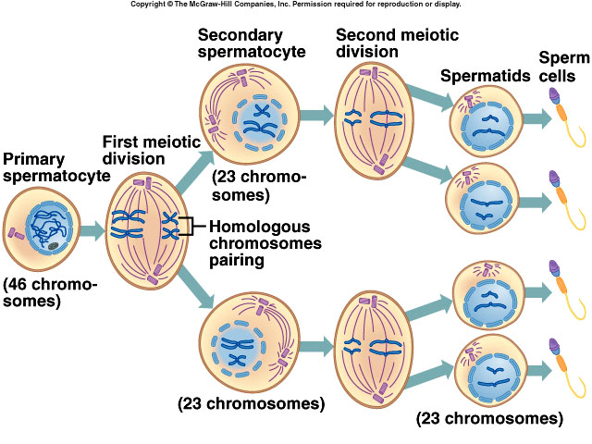
Spermatogenesis
22-7

Slide 17
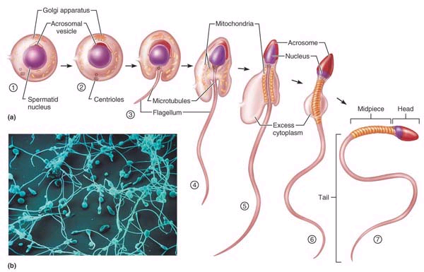

Slide 18
Female Hormonal System
The female hormonal system, like that of the male, consists of three hierarchies of hormones, as follows:
1. A hypothalamic releasing hormone, gonadotropin- releasing hormone (GnRH)
2. The anterior pituitary sex hormones, follicle- stimulating hormone (FSH) and luteinizing hormone (LH), both of which are secreted in response to the release of GnRH from the hypothalamus
3. The ovarian hormones, estrogen and progesterone, which are secreted by the ovaries in response to the two female sex hormones from the anterior pituitary gland

Slide 19
Significant results of the female sexual cycle
First, only a single ovum is normally released
from the ovaries each month, so that normally only a single fetus will begin to grow at a time.
Second, the uterine endometrium is prepared in advance for implantation of the fertilized ovum at the required time of the month.

Slide 20
Ovarian Cycle
Monthly series of events associated with the maturation of an egg
Follicular phase – period of follicle growth (days 1–14)
Luteal phase – period of corpus luteum activity (days 14–28)
Ovulation occurs midcycle

Slide 21
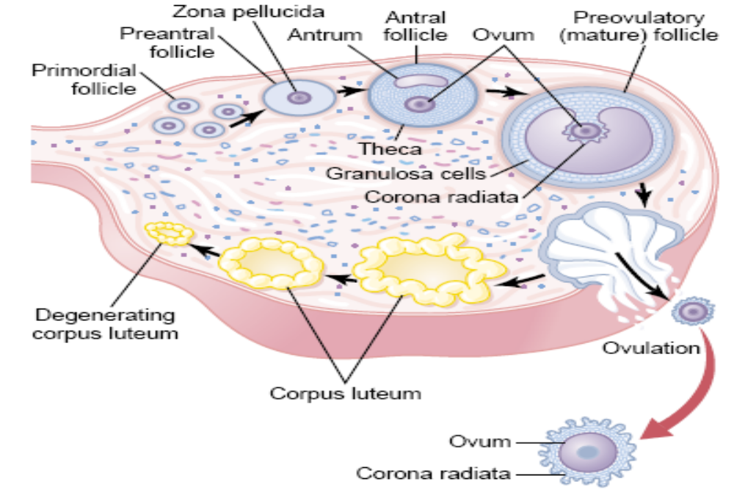
Ovarian Follicle Growth— “Follicular” Phase of the Ovarian Cycle

Slide 22
Follicular Phase
The primordial follicle, directed by the oocyte, becomes a primary follicle at puberty when FSH and LH from the anterior pituitary gland begin to be secrete
Primary follicle becomes a secondary follicle with FSH
  The initial effect is rapid proliferation of the granulosa cells, giving rise to theca secretes a follicular fluid that contains a high concentration of estrogen.
  The zona pellucida forms around the oocyte
  The antrum is formed
  Only One Follicle Fully Matures Each Month, and the Remainder
  Undergo Atresia.

Slide 23
Follicular Phase
The secondary follicle becomes a vesicular follicle by estrogen
  The antrum expands and isolates the ovum and the corona radiata
  The full size follicle (vesicular follicle) bulges from the external surface of the ovary

Slide 24
Ovulation
Ovulation occurs when the ovary wall ruptures and expels the ovum
Mittelschmerz – a twinge of pain sometimes felt at ovulation
1-2% of ovulations release more than one ovum, which if fertilized, results in twins

Slide 25
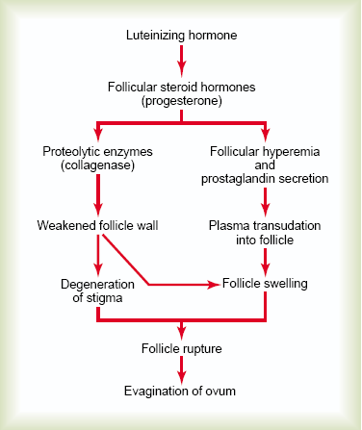
Postulated mechanism of ovulation.

Slide 26
Luteal Phase
After ovulation, the ruptured follicle collapses, granulosa cells enlarge, and along with internal thecal cells, form the corpus luteum
The corpus luteum secretes progesterone and estrogen
If pregnancy does not occur, the corpus luteum undergoes(1) proliferation, (2) enlargement, and (3) secretion, followed by (4) degeneration degenerates in 10 days, leaving a scar (corpus albicans)
If pregnancy does occur, the corpus luteum produces hormones until the placenta takes over that role (at about 3 months)

Slide 27
Uterine (Menstrual) Cycle
Series of cyclic changes that the uterine endometrium goes through each month in response to ovarian hormones in the blood
Days 1-5: Menstrual phase – uterus sheds all except the deepest part of the endometrium
Days 6-14: Proliferative (preovulatory) phase – Under the influence of estrogens, secreted in increasing quantities by the ovary during the first part of the monthly ovarian
cycle, the stromal cells and the epithelial cells proliferate rapidly, endometrium rebuilds itself

Slide 28
Conti..
Days 15-28: Secretory (postovulatory) phase – after ovulation has occurred, progesterone and estrogen together are secreted in large quantities by the corpus luteum.
endometrium prepares for implantation of the embryo
progesterone causes marked swelling and secretory development of the endometrium.
the blood vessels becoming highly tortuous

Slide 29
Menses
If fertilization does not occur, progesterone levels fall, depriving the endometrium of hormonal support
Spiral arteries kink and go into spasms and endometrial cells begin to die
The functional layer begins to digest itself
Spiral arteries constrict one final time then suddenly relax and open wide
The rush of blood fragments weakened capillary beds and the functional layer sloughs

Slide 30
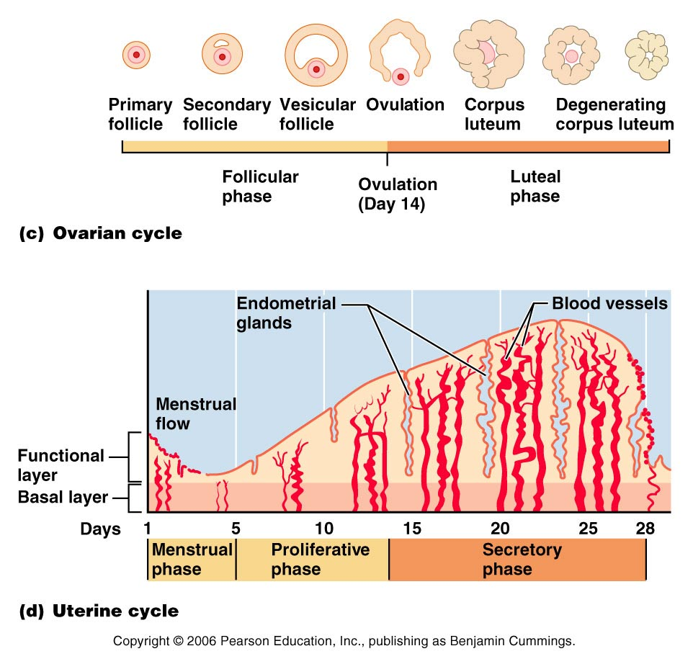
Gonadotropins, Hormones, and the Ovarian and Uterine Cycles
Figure 27.22c, d

Slide 31
Menopause
Ovulation and menses cease entirely
Without sufficient estrogen, reproductive organs and breasts atrophy
  Irritability and depression result
  Skin blood vessels undergo intense vasodilation (hot flashes occur)
  Gradual thinning of the skin anddecreased strength and calcification of bones throughout the body
  “hot flushes” characterized by extreme flushing of the skin,
  psychic sensations of dyspnea,
  fatigue,
  anxiety.

Slide 32
Extrauterine Effects of Estrogens and Progesterone
Estrogen levels rise during puberty
Promote oogenesis and follicle growth in the ovary
Exert anabolic effects on the female reproductive tract
  Uterine tubes, uterus, and vaginal growth and become functional
  Uterine tubes and uterus exhibit enhanced motility
  Vaginal mucosa thickens and external genitalia mature

Slide 33
Estrogen-Induced Secondary Sex Characteristics
Growth of the breasts by (1) development of the stromal tissues of the breasts, (2) growth of an extensive ductile system, and (3) deposition of fat in the breasts
Increased deposition of subcutaneous fat, especially in the hips and breasts
Widening and lightening of the pelvis
Growth of axillary and pubic hair

Slide 34
Functions of Progesterone
Effect of Progesterone on the Uterus. Promotes secretory changes in the uterine endometrium during the latter half of the monthly female sexual cycle, thus preparing the uterus for implantation of the fertilized ovum.
Effect of Progesterone on the Fallopian Tubes. promotes increased secretion by the mucosal lining of the fallopian tubes
Effect of Progesterone on the Breasts. Progesterone promotes development of the lobules and alveoli of the breasts, causing the alveolar cells to proliferate, enlarge, and become secretory in nature

Slide 35
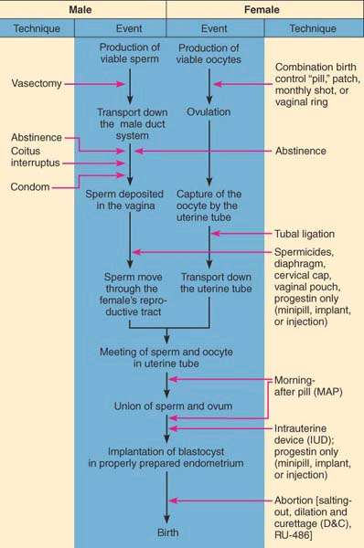


Slide 36
Methods of contraception
Coitus interruptus, or outer ejaculation is never assured.
Rhythm or temporary abstinence methods or calendar method involve avoiding intercourse during periods of ovulation or fertility. This may be accomplished by
  recording daily basal body temperatures (body temperature drops slightly immediately prior to ovulation and then rises slightly after ovulation).
With a failure rate of 10–20%, it is obvious that some people are willing and some are not.

Slide 37
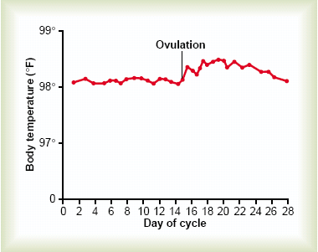

Slide 38
Barrier methods, such as diaphragms, cervical caps, male and female condoms, spermicidal foams, gels, and sponges, are quite effective

Slide 39
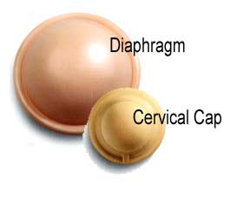
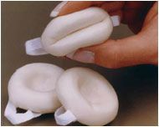

Slide 40
The most used contraceptive method was the intrauterine device (IUD): (Copper T)
Copper is toxic to sperm. It makes the uterus and fallopian tubes produce fluid that kills sperm. This fluid contains copper ions, enzymes, and prostagladins.
Developed in 1909, this plastic or metal device is inserted into the uterus and prevents the fertilized egg from implanting in the endometrial lining.

Slide 41
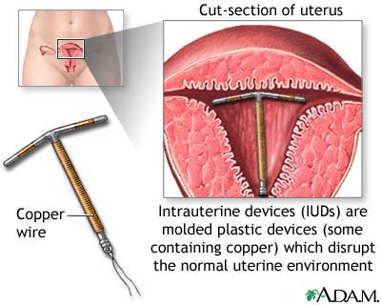
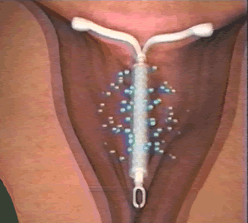

Slide 42
The birth control pill, or simply “the pill,” first marketed in 1960.
Supplied in 28-tablet packets, the first 20 or 21 tablets contain minute amounts of estrogens and progestins (progesterone-like hormones) taken daily; the last seven tablets are hormone free.
The pill tricks the hypothalamic-pituitary axis and the relatively constant blood levels of ovarian hormones make it appear that the woman is pregnant. And no pituitary hormones are released.
Ovarian follicles do not develop and ovulation ceases.

Slide 43
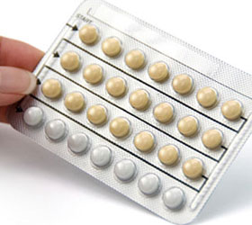

Slide 44
Emergency contraceptive pills.
Combination birth control pills with substantially higher hormone concentrations (marketed under various names including Ovral, Tetragynon, and Triphasil) are being used for postcoital contraception.
Taken within three days of unprotected intercourse, these morning-after pills (MAPs) “mess up” normal hormonal signals enough to prevent a fertilized egg from implanting or prevent fertilization altogether.

Slide 45
Other hormonal approaches to contraception include
  Norplant, which consists of two (originally six) tiny silicone rods implanted just under the skin that release progestin over a five-year period; and
  Depo-Provera, an injectible form that lasts for three months.
    causing the cervical mucus to become thick, thus blocking sperm entry into the uterus, and make the endometrium inhospitable to implantion

Slide 46
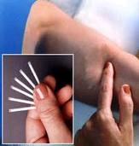
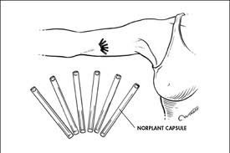

Slide 47
Abortion is the termination of a pregnancy that is in progress. Spontaneous abortion, also called miscarriage, is common and frequently occurs.
Mifepristone (RU-486), the so-called abortion pill developed in France, enables a woman to end a pregnancy during the first 7 weeks and has a 96–98% success rate with few side effects.
RU-486 is an antihormone that, when taken along with a tiny amount of prostaglandin to stimulate uterine contractions, induces miscarriage by blocking progesterone’s quieting effect on the uterus.

Slide 48
Lactation
Growth of the Ductal System—
  Role of the Estrogens.
Development of the Lobule-Alveolar System—
  Role of Progesterone.
Initiation of Lactation—
  Function of Prolactin
Ejection (or “Let-Down”) Process in Milk Secretion
  Function of Oxytocin

Slide 49
The functions of the mammary glands are the synthesis, se- cretion, and ejection of milk; these functions, called lactation

Slide 50
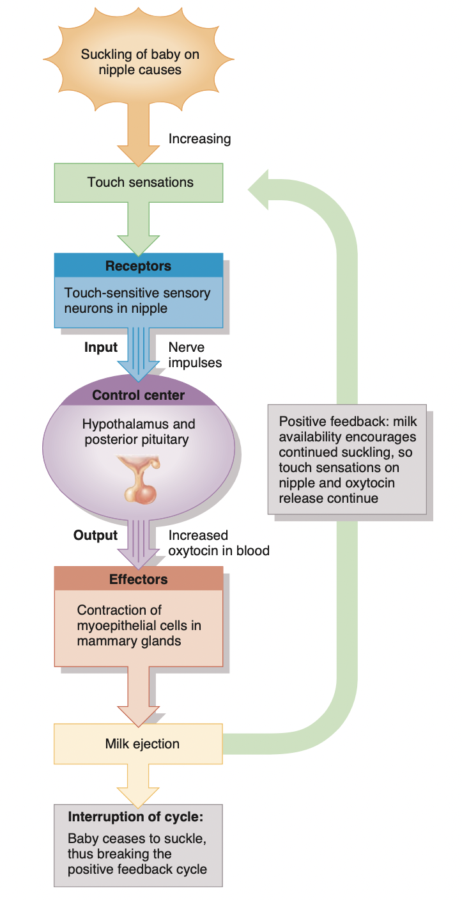

Slide 51
Physiological changes during pregnancy
Near the end of the third month of pregnancy, the uterus occupies most of the pelvic cavity.
Toward the end of a full-term pregnancy, the uterus fills nearly the entire abdominal cavity. It pushes the maternal intestines, liver, and stomach superiorly, elevates the diaphragm, and widens the thoracic cavity. In the pelvic cavity, compression of the ureters and urinary bladder occurs.
Pregnancy-induced physiological changes
  weight gain due to the fetus, amniotic fluid, the placenta, uterine enlargement, and increased total body water; increased storage of proteins, triglycerides, and minerals; marked breast enlargement in preparation for lactation; and lower back pain due to lordosis (hollow back).

Slide 52
Several changes occur in the maternal cardiovascular system.
  Stroke volume increases by about 30% and cardiac output rises by 20–30% due to increased maternal blood flow to the placenta and increased metabolism.
  Heart rate increases 10–15% and blood volume increases 30–50%, mostly during the second half of pregnancy. These increases are necessary to meet the additional demands of the fetus for nutrients and oxygen.
  Compression of the renal artery can lead to renal hypertension.

Slide 53
Respiratory changes.
  Tidal volume can in- crease by 30–40%, expiratory reserve volume can be reduced by up to 40%, functional residual capacity can decline by up to 25%, minute ventilation (the total volume of air inhaled and ex- haled each minute) can increase by up to 40%, Dyspnea also occurs.
Digestive system changes.
  Pregnant women experience an increase in appetite due to the added nutri- tional demands of the fetus. A general decrease in GI tract motility can cause constipation, delay gastric emptying time, and produce nausea, vomiting, and heartburn.

Slide 54
Urinary system changes
  An increase in renal plasma flow up to 35% and an increase in glomerular filtration rate up to 40% increase the renal filtering capacity, which allows faster elimination of the extra wastes produced by the fetus.
Changes in the skin
  Some women experience increased pigmentation around the eyes and cheekbones in a mask like pat-tern (chloasma), in the areolae of the breasts. Striae (stretch marks) over the abdomen can occur as the uterus enlarges, and hair loss increases.
Changes in the reproductive system
  Edema and increased vascularity of the vulva and increased pliability and vascularity of the vagina. The uterus increases from its nonpregnant mass of 60–80 g to 900–1200 g at term because of hyperplasia of muscle fibers in the myometrium in early pregnancy and hypertrophy of muscle fibers during the second and third trimesters.

Slide 55
Klinefelter’s syndrome A sex chromosome aneuploidy, usually due to trisomy XXY, that occurs once in every 500 births. Such individuals are somewhat mentally disadvantaged, sterile males with undeveloped testes, scant body hair, and enlarged breasts.
Turner’s syndrome A sex chromosome aneuploidy caused by the presence of a single X chromosome (designated XO); occurring about once in every 5000 births, it produces a sterile female with virtually no ovaries and limited development of secondary sex characteristics. Other features include short stature, webbed neck, under- developed breasts, and widely spaced nipples. Intelligence usually is normal.

